Slide 1
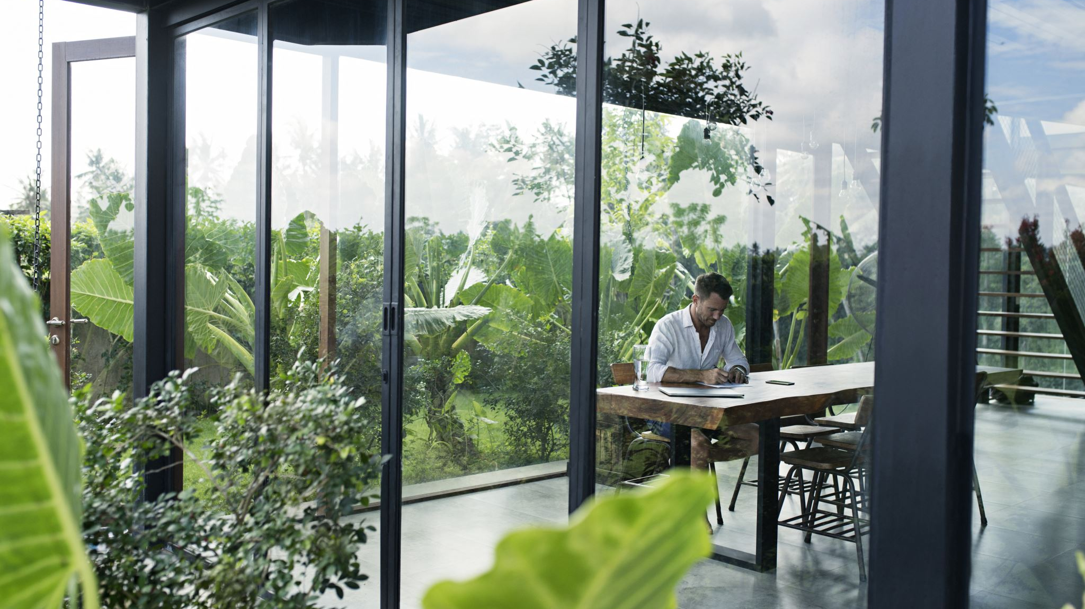
Cartoonifying an Image using Deep Learning
Made by : Nilesh Popli
2016881
Guided By : Dr Vikas Tripathi
Associate Professor, Dean(R&D), GEU Dehradun

Slide 2
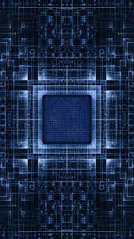
Tools Used
Python: We use python as a programming language for building the application.
cv2: We use cv2 for image processing.
Numpy: Here the images that we use are stored in the form of arrays. So, for that, we use NumPy.
easygui: easygui is a module used for GUI programming in python.
Matplotlib: Matplotlib is used for visualization purposes. Here we plot the images using matplotlib.
Tkinter: Tkinter is a standard Graphical User Interface (GUI) package.

Slide 3
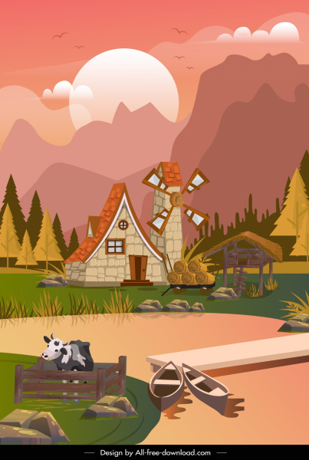
Cartoonization
Cartoonization:
The process of converting real-life high-quality pictures into practical cartoon scenes is known as cartoonization.
Social media is extensively used these days. Be it images, blog posts, artwork, tweets, memes, opinions and what not being used to seek attention of followers or friends to create influence or to connect with them on such social platforms.
You can use a photo of your own in a profile image, create an amusing avatar or turn your photo into a cartoon

Slide 4
OpenCV Open-source software containing pre-built functions and algorithms used for implementing Image Processing and Computer Vision. The python library that we will be using is “cv2”. We will be using some of those built-in functions to process our input image.
Blurring
Blurring in terms of digital image processing is smoothing of the image, removing noise from it. Filtering is one of the fundamental operations of Image Processing. Filters like Gaussian Blur, Median Blur, blur images, but they also tend to smooth the edges. To avoid that we will use the Bilateral Filter.
K-Means Clustering
K-Means clustering is a clustering algorithm in which n observations are partitioned into k clusters. Each pixel in an image is represented by 8 bits, which means each color channel can have 256 possible shades/values. Output image, instead of having a variety of shades will have clusters of same shades.
Erosion
Erosion is a morphological process that mostly deals with altering shapes in an image. Dilation and erosion are sister processes. In simple terms, they are used to thicken or lessen boundary shapes in an image. We will use it to erosion to thicken the contour boundaries to make them stand out.
Canny Edge-detection
Canny is a famous edge detection technique that uses the Canny 86 algorithm to detect edges. Since any edge detection technique is prone to noise in the image, we use the bilateral filter to remove them.

Slide 5
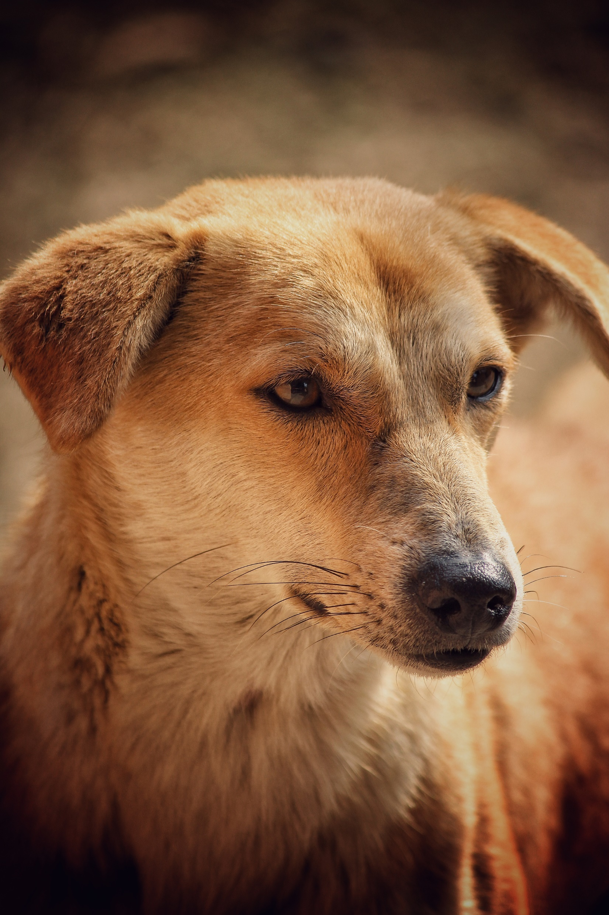
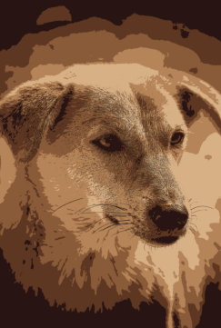
Working
The basic concept in this algorithm involves the technique of converting the RGB color image to an accurate, cartooned image without multiple filtrations or blurred image without proper facilitation of edge detection.
This user interface allows to apply the animation effects. This naturally provides an artistic effect and comics as well with wide range of pictures
It includes origin and history of image processing , different types of uncertain environment , existing methos for cartoon imaging. An example image processing is helpful to issue in signature recognition , Digital video Processing , Remote sensing, and finance

Slide 6
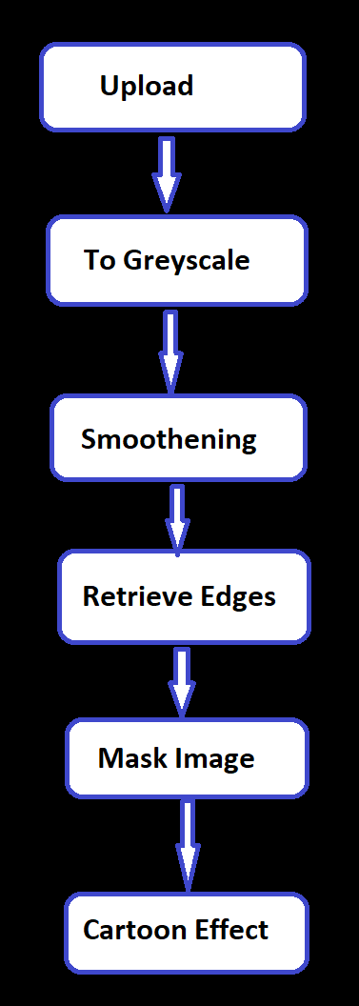
Working Methodology
Step 1: Importing the required modules
Step 2: Building a File Box to choose a particular file
Step 3: Loading & Storing Image
Step 4: Transforming an image to grayscale
Step 5: Smoothening a grayscale image
Step 6: Retrieving the edges of an image
Step 7: Preparing a Mask Image
Step 8: Perform color quantization technique
Step 9: Giving a Cartoon Effect
Step 10: Plotting all the transitions together

Slide 7

Result and Inference
In this OpenCV project, we’ve developed an image cartoonizer application using python. From this project, we’ve learned about thresholding and edge finding from an image, K-means clustering algorithm, color quantization technique, and some other basic image processing techniques.
.The main attraction of the paper is to solve different types of images having one object, two object and three object which can’t be solved by any of the exiting methods but can be solved by our proposed method.

Slide 8
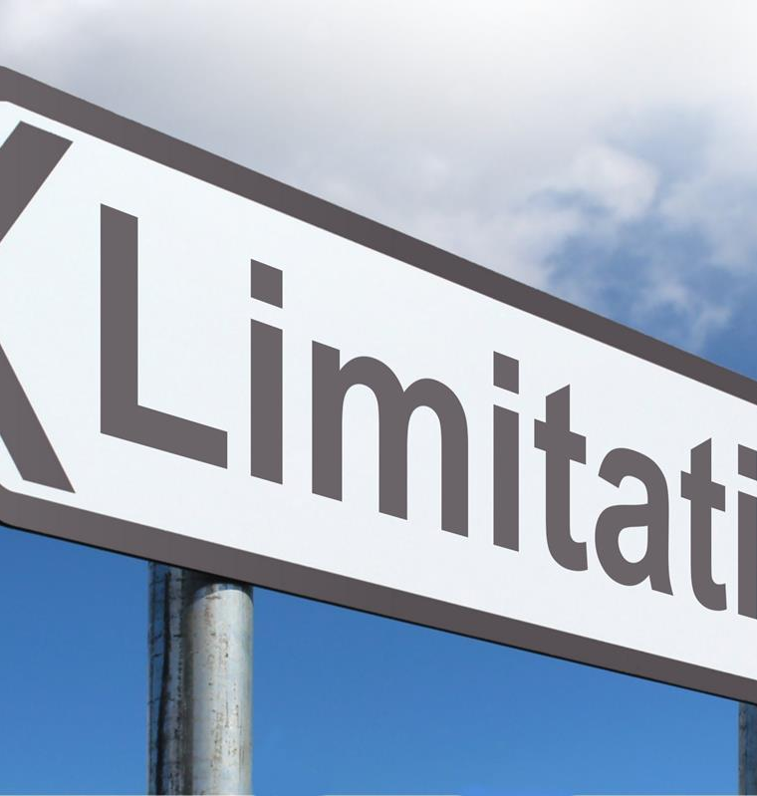
Limitations and Future Scope
The cartooning of images has a tremendous scope in the animation industry. Animated pictures are frequently used in advertisements to keep the audience engaged. Cartooning of images also have a huge scope to print publications, and publishing companies. Gaming sector is also looking very promising.
Currently the system is facing issues with face cartoonization. This can be improved by providing more facials data with different perspective to the model. The resolution of the output also needs to be increased.

Slide 9
Applications
This paper is presented for an efficient method for extracted cartoon effects. The test result shows that the developed method could extract meaningful object will in different characters and backgrounds.
This application aims to enables people with visual impartment to live more independently.
Cartoonizing an image will transform an image into its cartoon image. It makes an image looks vicious and like water paint , removing the roughness in colors.

Slide 10
Thank You

